Slide 1
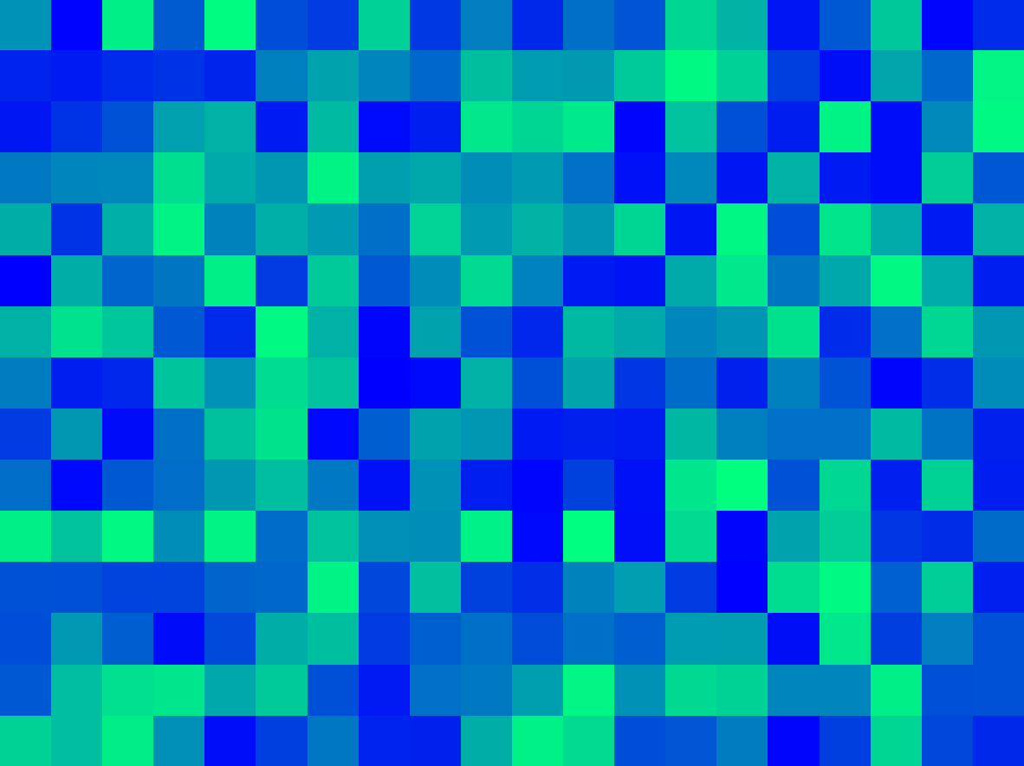
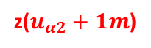
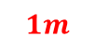

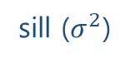
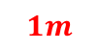
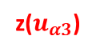
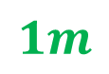
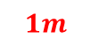
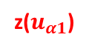
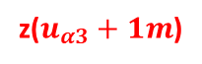
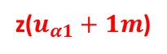

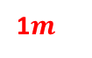
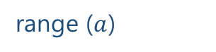

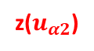
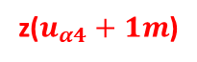
$$1m$$
variance ($γ$)
z($u_{α1}$)
z($u_{α1}+1m$)
sill ($σ^{2}$)
$$1m$$
$$1m$$
1$m$
nugget ($c_{0}$)
z($u_{α4}$)
z($u_{α4}+1m$)
z($u_{α2}$)
z($u_{α2}+1m$)
$$1m$$
range ($a$)
z($u_{α3}$)
z($u_{α3}+1m$)
lag distance (h)

Slide 2



























Population
Samples
aegis4048.github.io
aegis4048.github.io

Slide 3
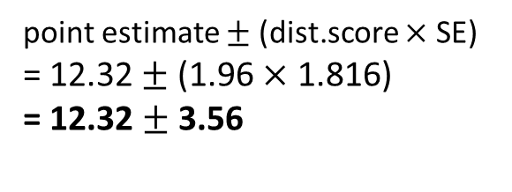
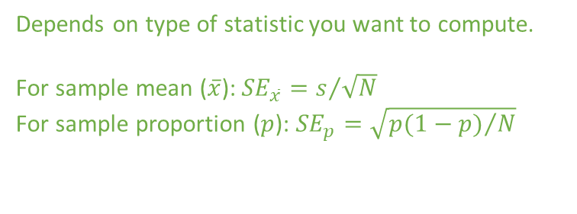
Depends on type of distribution. Tells how many standard deviation away is the limit from the center
point estimate $±$ (dist.score $×$ SE)
= 12.32 $±$ (1.96 $×$ 1.816)
= 12.32 $±$ 3.56
Depends on type of statistic you want to compute.
For sample mean ($\overline{x}$): ${SE}_{\overline{x}}=s/{\sqrt{N}}$
For sample proportion ($p$): ${SE}_{p}=\sqrt{{p(1−p)}/N}$

Slide 4
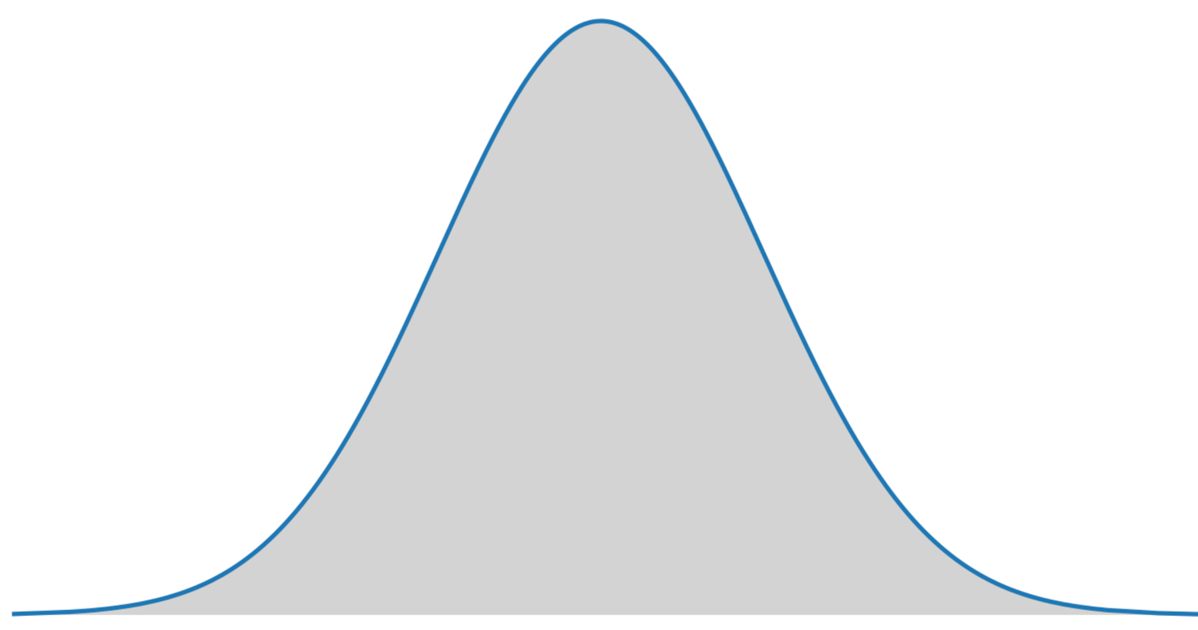
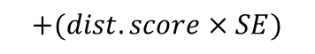
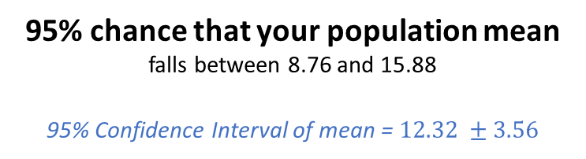
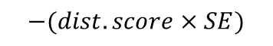
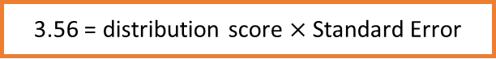
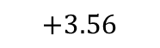
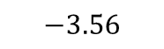
Lower Limit
Upper Limit
8.76
95% chance that your population mean
falls between 8.76 and 15.88
95% Confidence Interval of mean = $12.32 ±3.56$
15.88
$$−3.56$$
$$+3.56$$
$$−(dist.score×SE)$$
$$+(dist.score×SE)$$
aegis4048.github.io
2.5%
outliers
3.56 = distribution score $×$ Standard Error
2.5%
outliers
Sample mean = 12.32

Slide 5

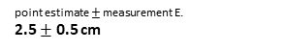
100% chance that your clip length
falls between 2cm and 3cm
2.?? cm
depends on tick mark spacing
1
2
3
4
5
6
7
8
point estimate $±$ measurement E.
2.5 $±$ 0.5 cm
cm
aegis4048.github.io

Slide 6
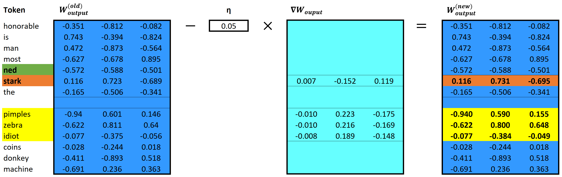
aegis4048.github.io
aegis4048.github.io

Slide 7
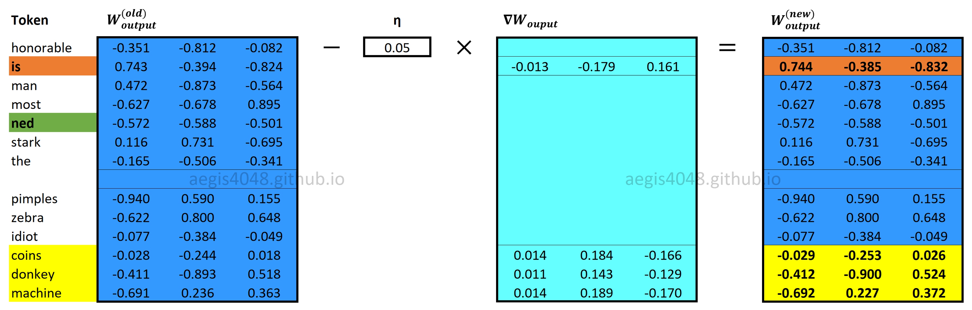

Slide 8
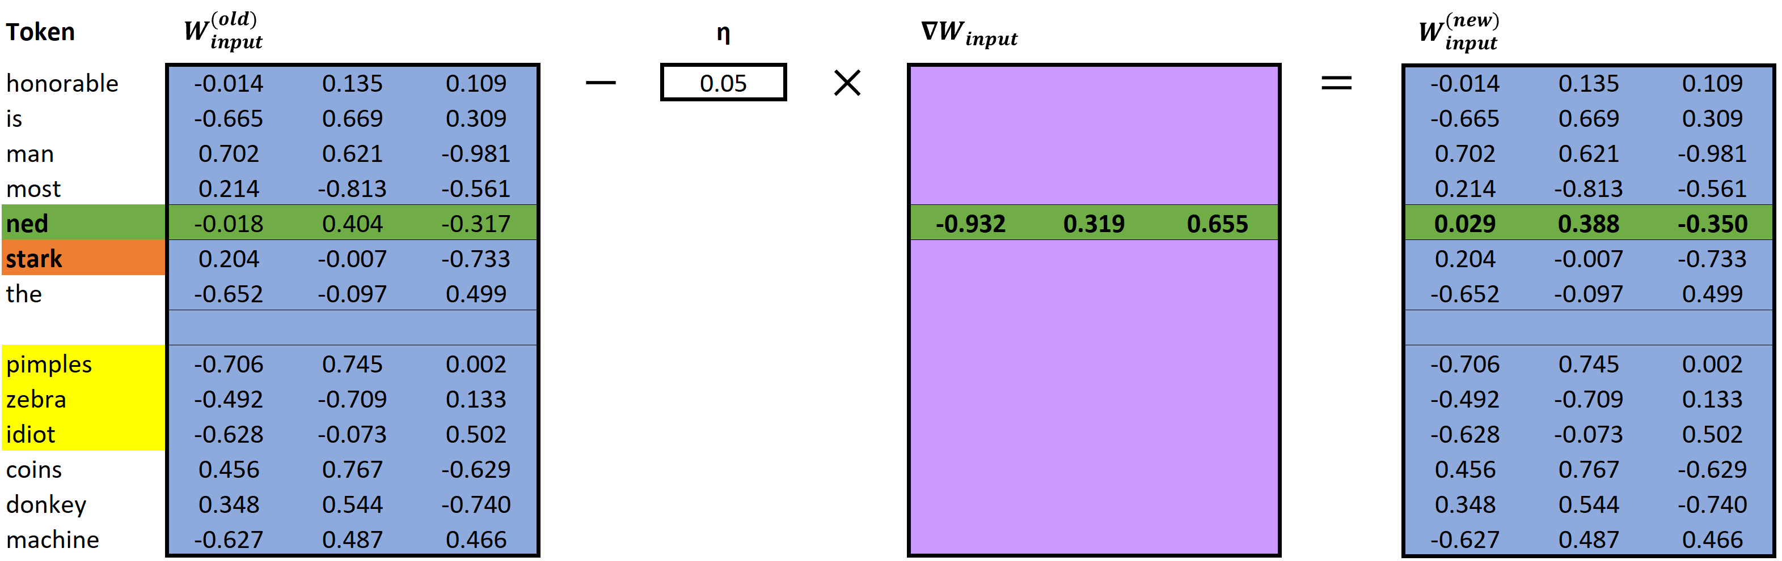
aegis4048.github.io
aegis4048.github.io

Slide 9
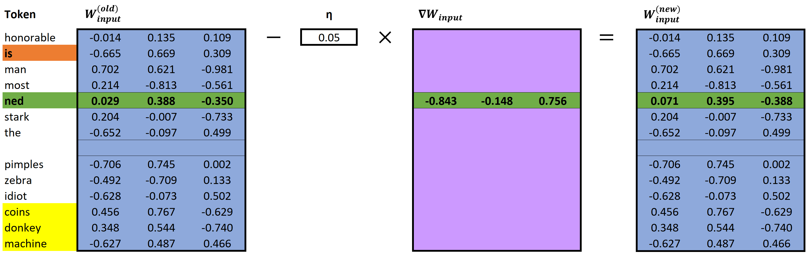
aegis4048.github.io
aegis4048.github.io

Slide 10
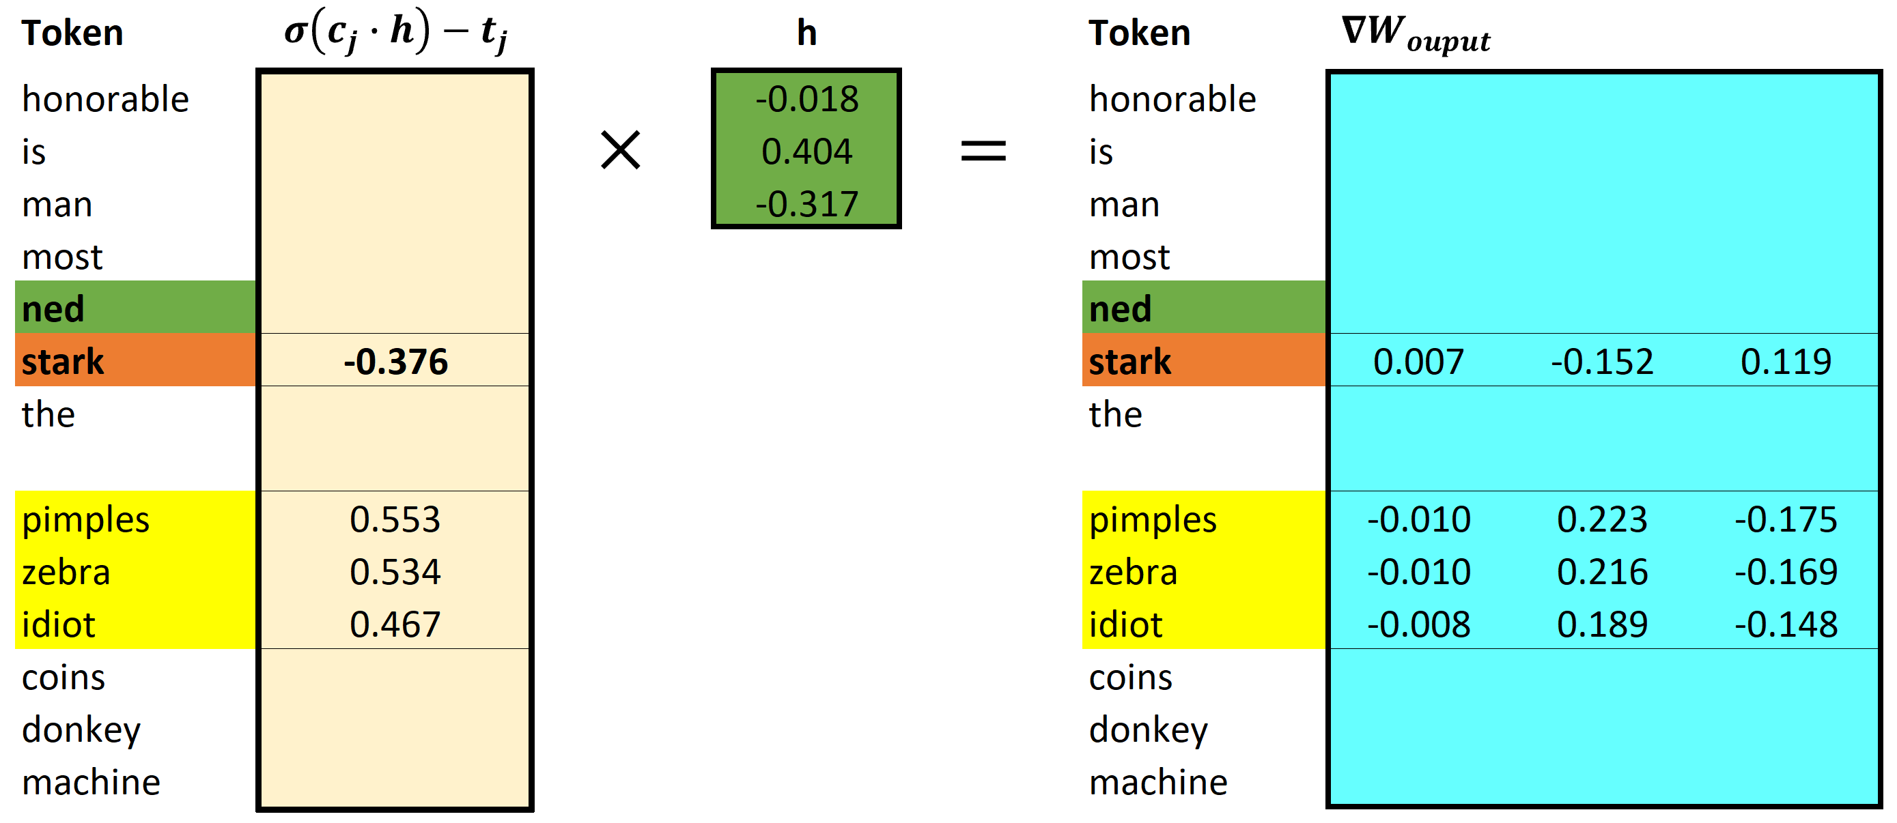
aegis4048.github.io
aegis4048.github.io

Slide 11
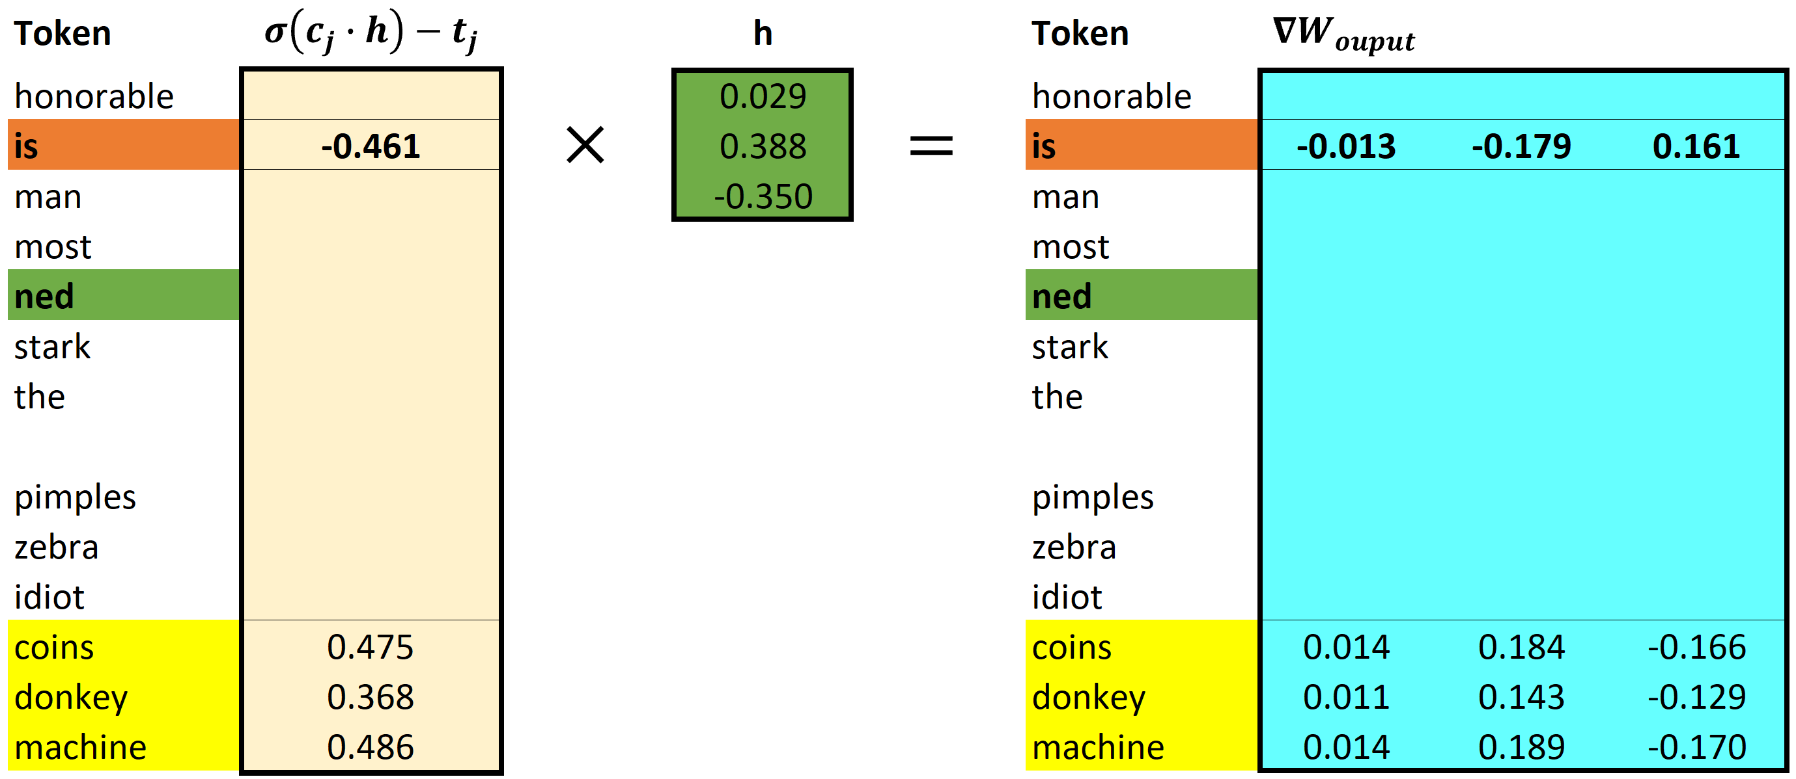
aegis4048.github.io
aegis4048.github.io

Slide 12
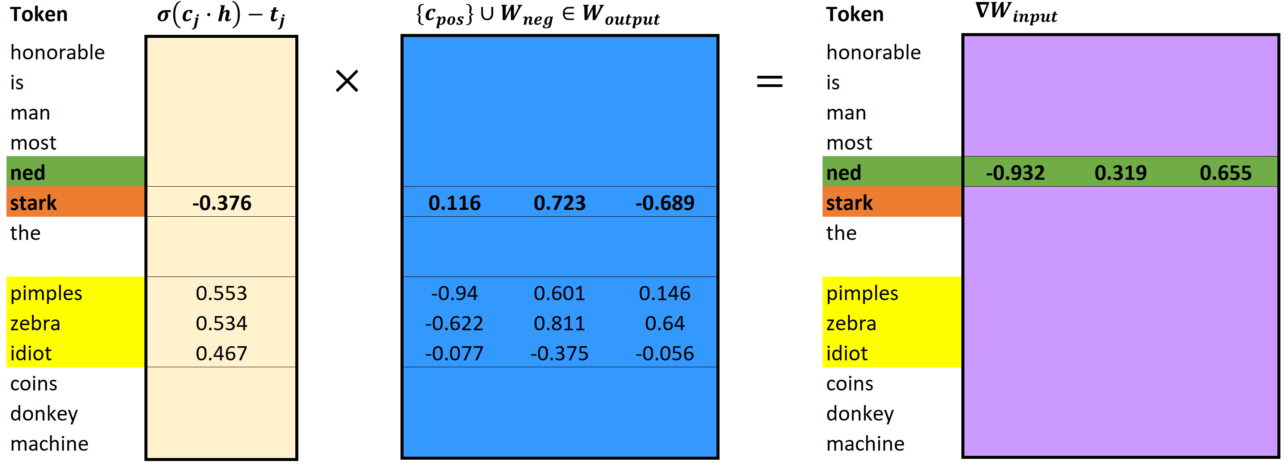
aegis4048.github.io
aegis4048.github.io

Slide 13
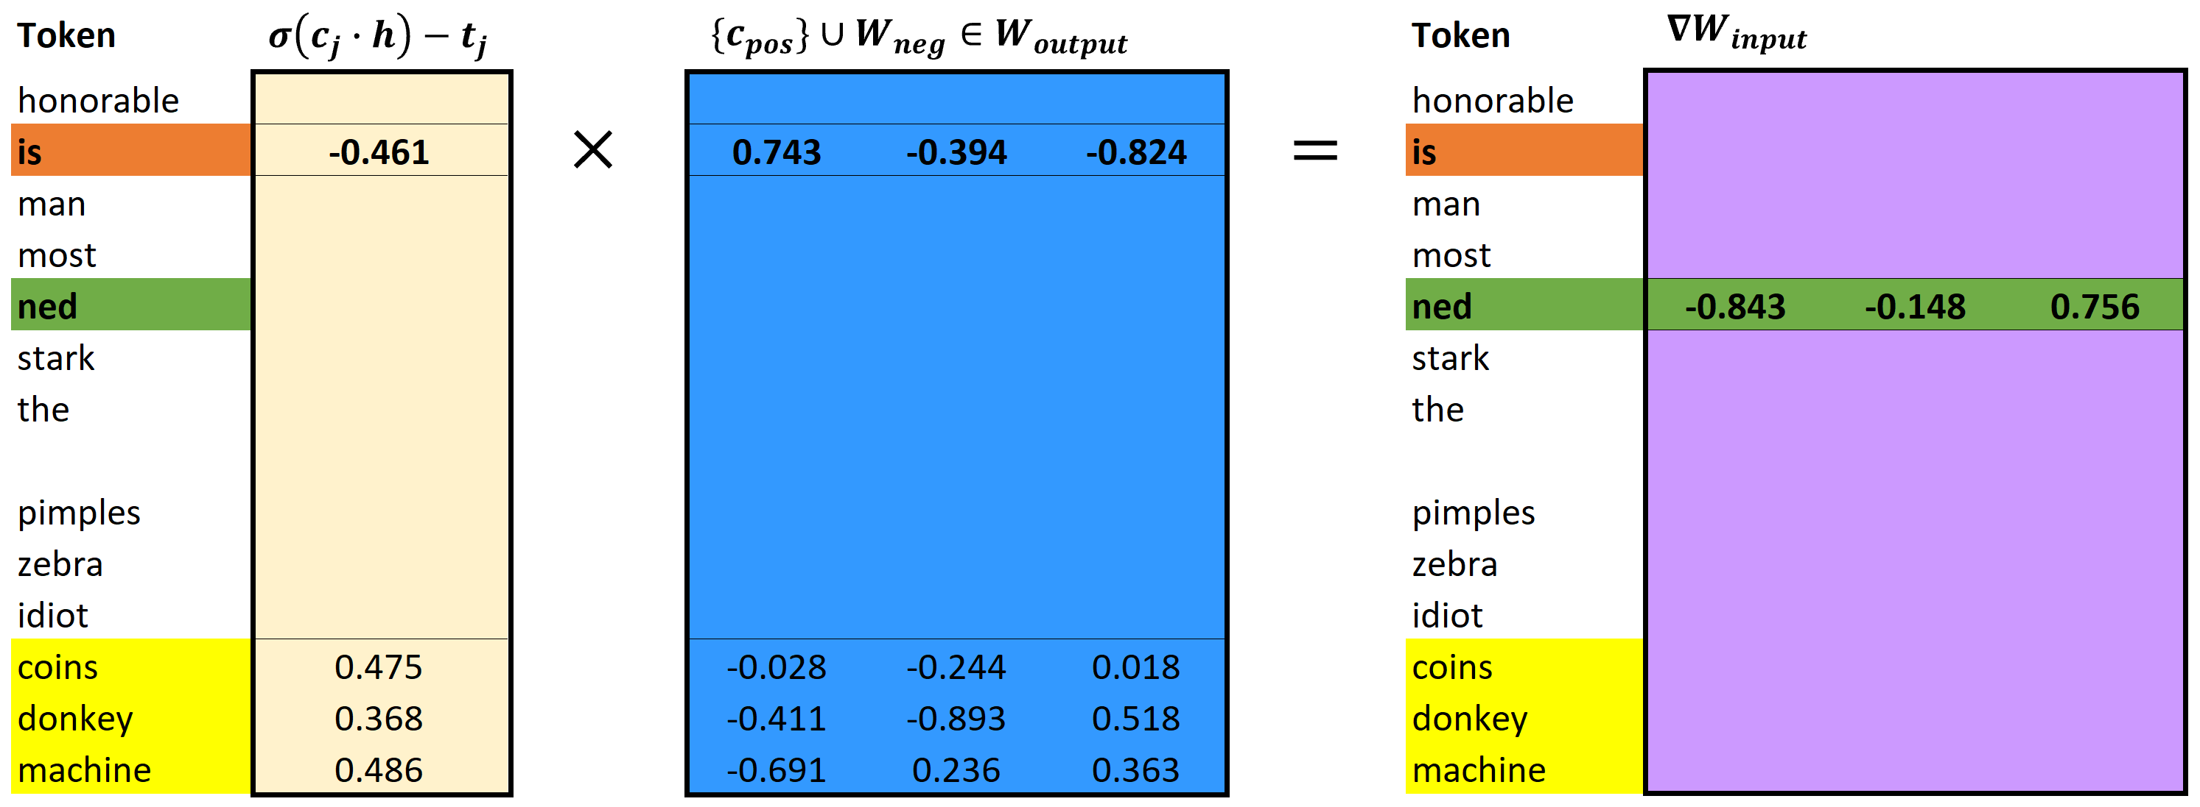
aegis4048.github.io
aegis4048.github.io

Slide 14
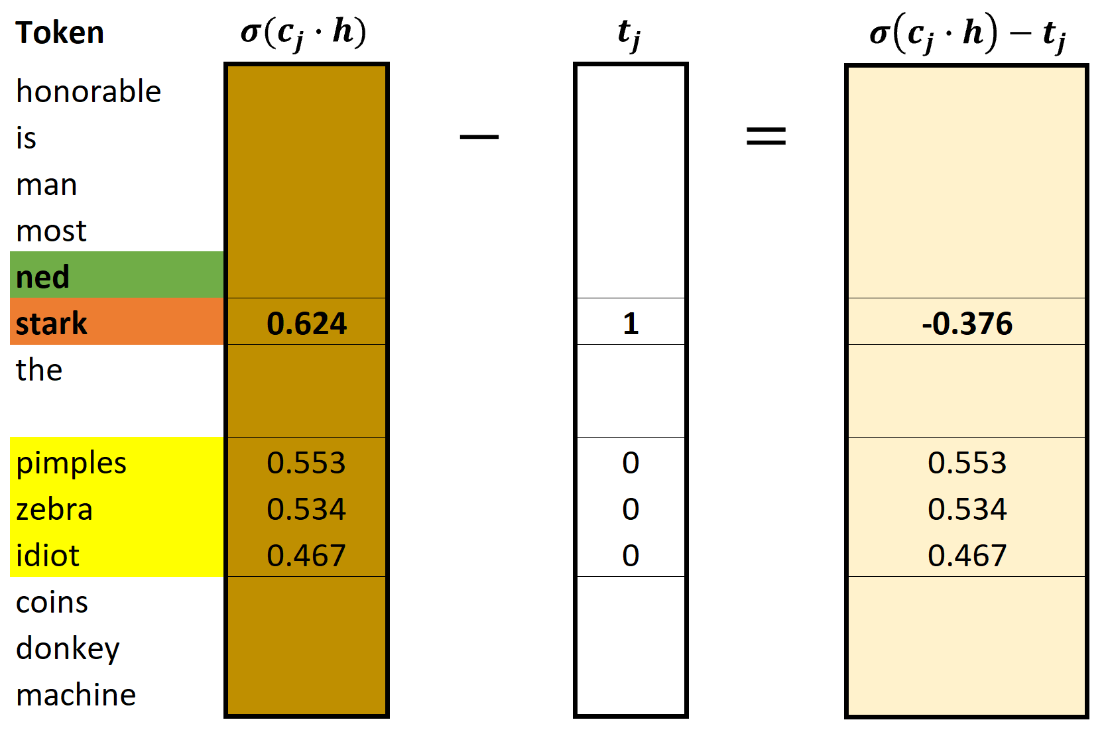
aegis4048.github.io
aegis4048.github.io

Slide 15
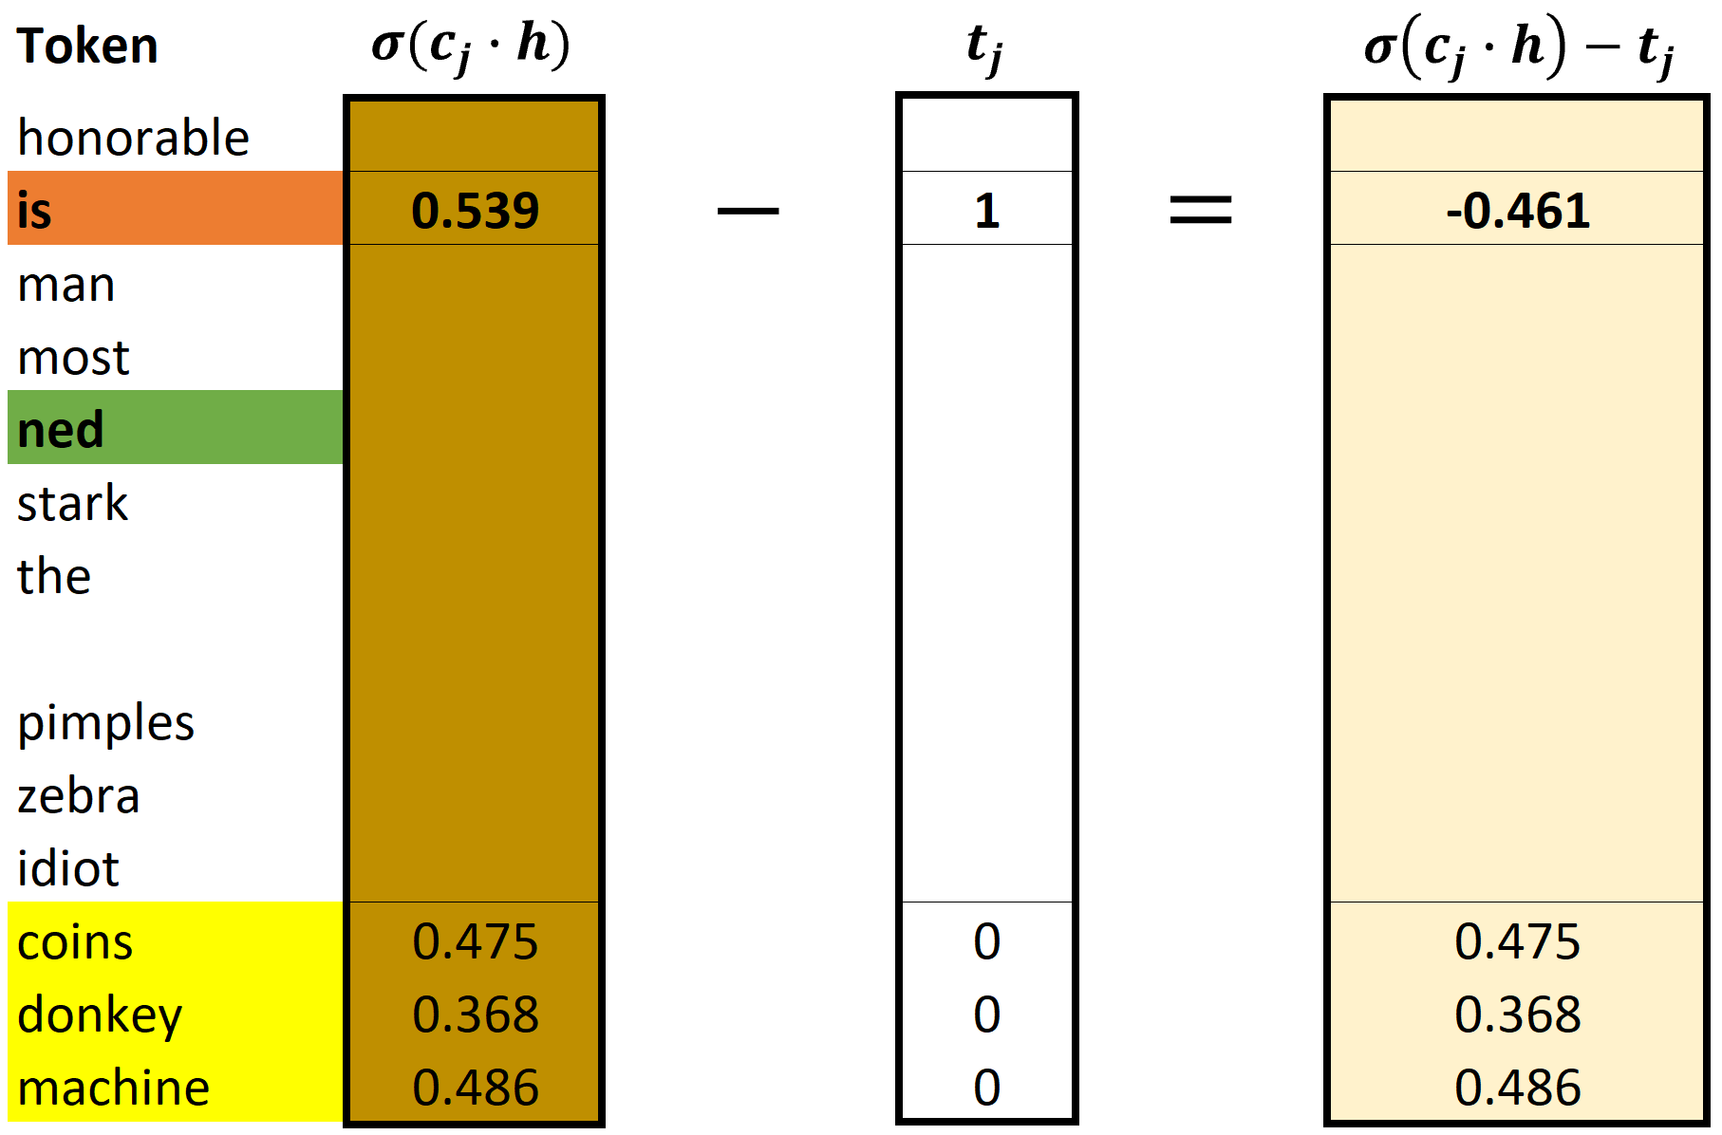
aegis4048.github.io
aegis4048.github.io

Slide 16
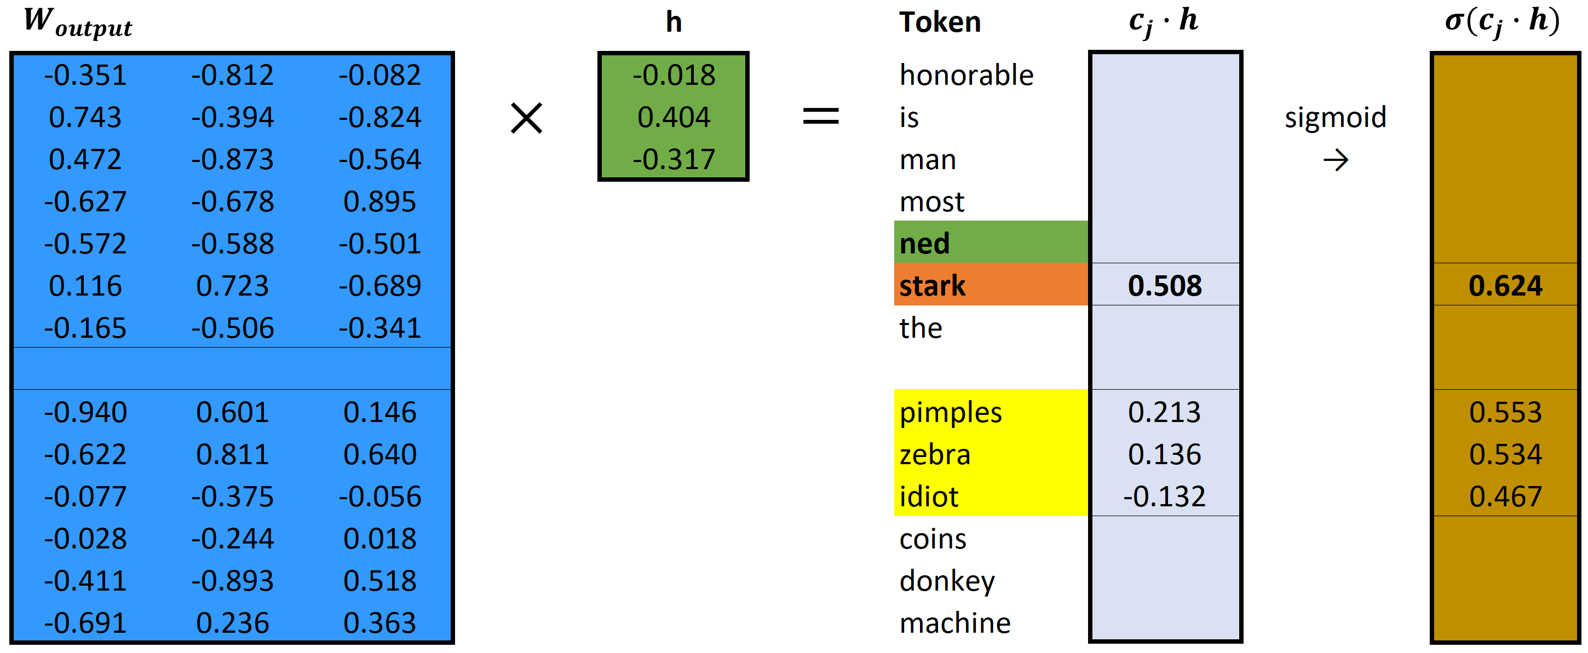
aegis4048.github.io
aegis4048.github.io

Slide 17
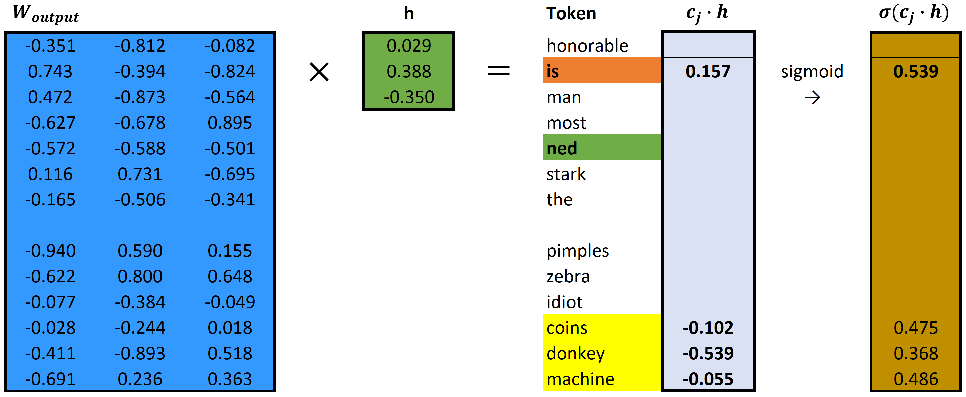
aegis4048.github.io
aegis4048.github.io

Slide 18
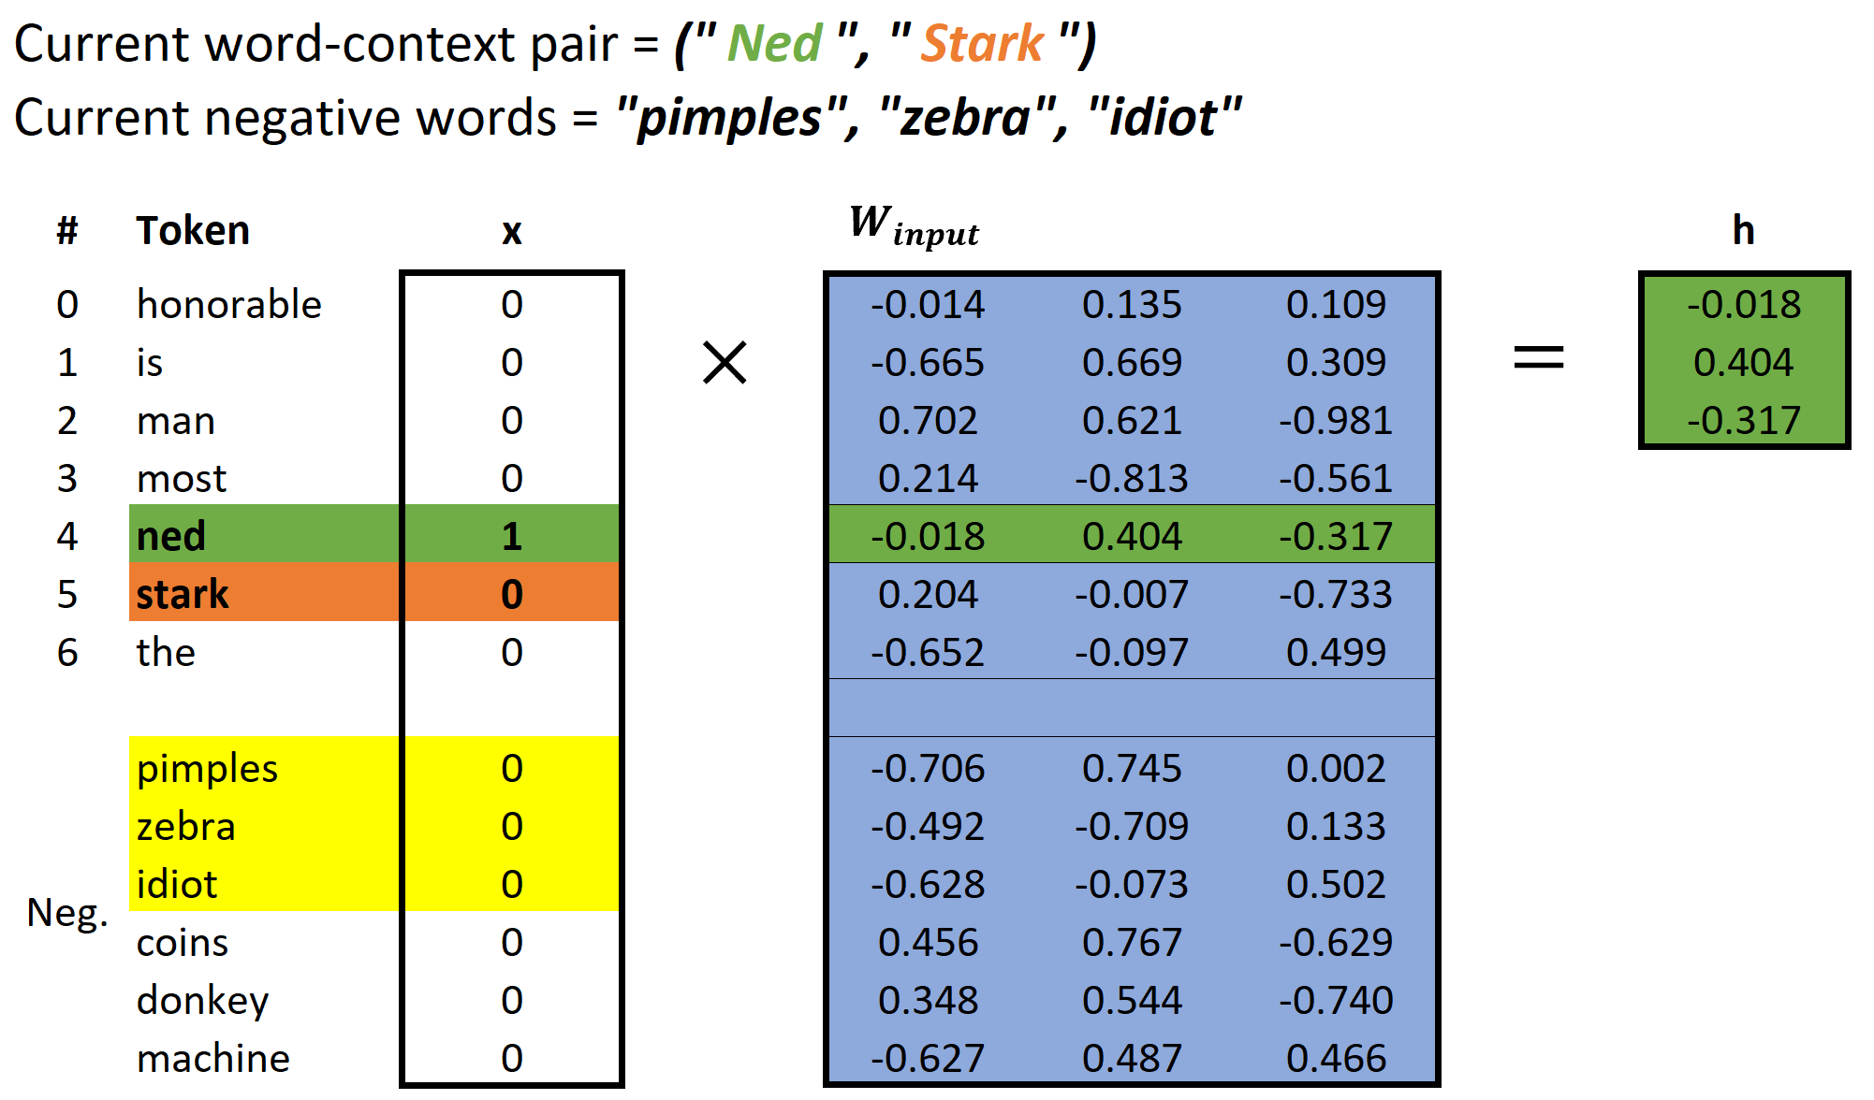

aegis4048.github.io

Slide 19
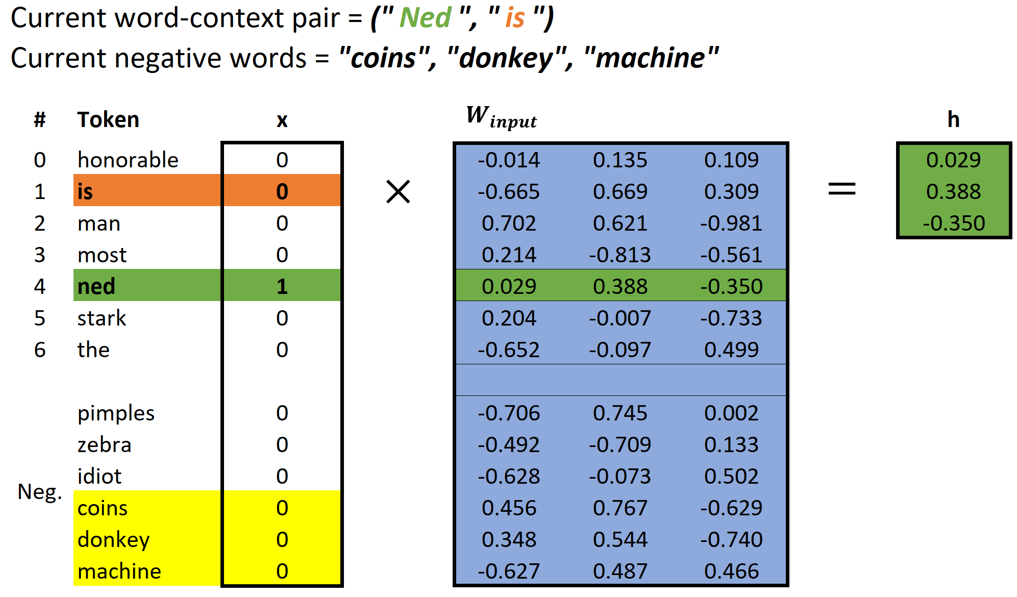
aegis4048.github.io

Slide 20
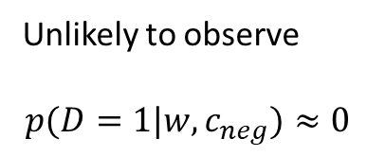
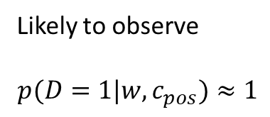
Binomial Classification
(regression, logistic)
(regression, zebra)
(regression, machine)
(regression, pimples)
(regression, sigmoid)
VS
(regression, Gangnam-Style)
(regression, supervised)
(regression, toothpaste)
aegis4048.github.io
(regression, neural)
(regression, idiot)
Likely to observe
$$p(D=1|w,c_{pos})≈1$$
Unlikely to observe
$$p(D=1|w,c_{neg})≈0$$

Slide 21
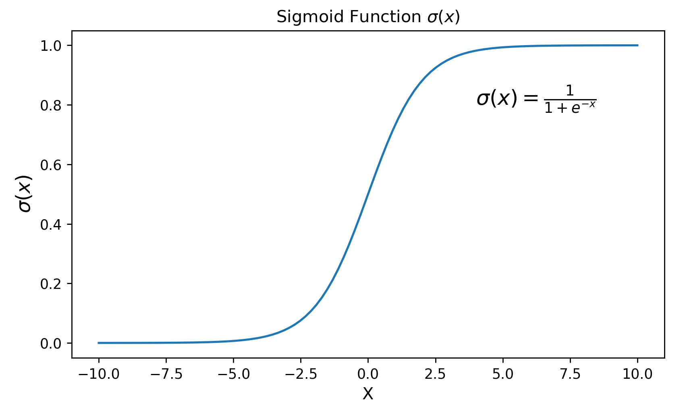
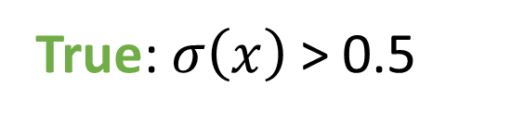
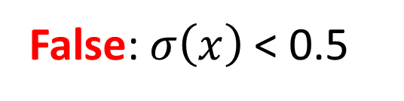
True: $σ\left(x\right)$ > 0.5
False: $σ\left(x\right)$ < 0.5
aegis4048.github.io

Slide 22
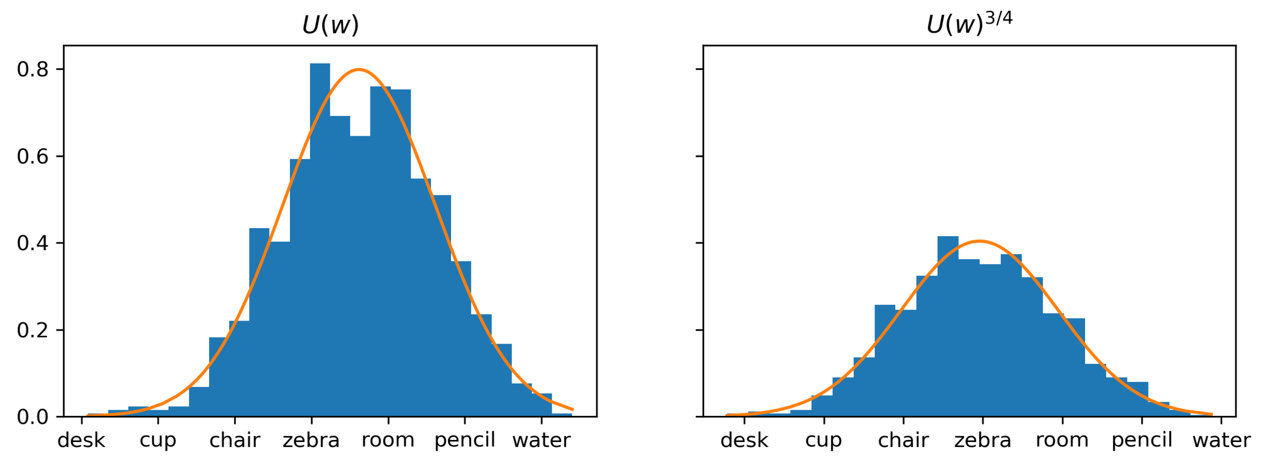
aegis4048.github.io
aegis4048.github.io

Slide 23
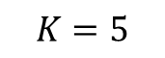
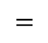
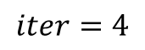
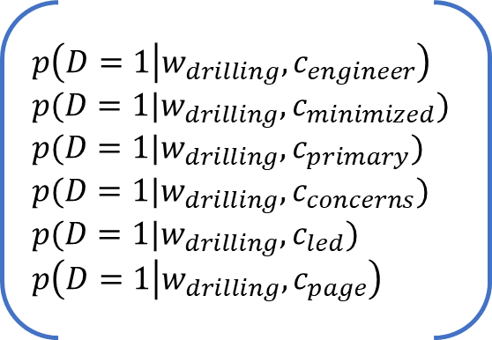
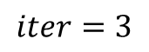





Center word: drilling
$$K=5$$
$$iter=1$$
$$iter=2$$
$$iter=3$$
$$iter=4$$
Current context word: engineer
$$p\left(D=1 | w_{drilling},c_{engineer}\right)$$
$$p(D=1|w_{drilling},c_{minimized})$$
$$p(D=1|w_{drilling},c_{primary})$$
$$p(D=1|w_{drilling},c_{concerns})$$
$$p(D=1|w_{drilling},c_{led})$$
$$p\left(D=1 | w_{drilling},c_{page}\right)$$
0.432
0.312
0.565
0.102
0.853
0.642
0.653
0.169
0.221
0.043
0.532
0.380
0.853
0.042
0.083
0.009
0.115
0.101
0.998
0.000
0.001
0.000
0.001
0.002
engineer
minimized
Update $θ$
Update $θ$
Update $θ$
primary
$$=$$
concerns
led
aegis4048.github.io
aegis4048.github.io
aegis4048.github.io
page

Slide 24
Drilling fluids serve to balance formation pressures while drilling to ensure wellbore stability. They also carry cuttings to the surface and cool the bit. The drilling engineer traditionally designs drilling fluids with two primary goals in mind:
To ensure safe, stable boreholes, which is accomplished by operating within an acceptable mud-weight window
To achieve high rates of penetration so that rig time and well cost can be minimized
These primary considerations do not include well productivity concerns. A growing recognition of the importance of drilling-induced formation damage has led to the use of drill-in fluids (fluids used to drill through the pay zone) that minimize formation damage. This page discusses the formation damage that may be associated with various types of drilling fluids.
current context word
aegis4048.github.io
aegis4048.github.io

Slide 25

Vanilla Skip-Gram
aegis4048.github.io
aegis4048.github.io
Negative Sampling
aegis4048.github.io
aegis4048.github.io

Slide 26




Complexity = $O\left(V+V\right)≈O\left(V\right)$
where $V$ is very large
Computed $V$ times
for all vocabs
aegis4048.github.io
$V$ computations are needed to get normalization factor

Slide 27

aegis4048.github.io

Slide 28

aegis4048.github.io

Slide 29

aegis4048.github.io
aegis4048.github.io
aegis4048.github.io

Slide 30

aegis4048.github.io
aegis4048.github.io
aegis4048.github.io

Slide 31

aegis4048.github.io

Slide 32

aegis4048.github.io
aegis4048.github.io
aegis4048.github.io

Slide 33

aegis4048.github.io
aegis4048.github.io
aegis4048.github.io

Slide 34





$$c=1$$
$$c=2$$
0.12
0.21
0.10
0.06
-0.87
0.09
0.12
0.21
0.10
0.06
0.13
-0.91
0.24
0.42
0.20
0.12
-0.74
-0.82
man
passes
$$\sum_{c=1}^{C}{e_{c}}=$$
sentence
$$+$$
$$=$$
should
aegis4048.github.io
the
who

Slide 35






$$y_{true}$$
($V$-dim)
$$y_{pred}−y_{true}$$
($V$-dim)
0
0
0
0
1
0
0.12
0.21
0.10
0.06
-0.87
0.09
man
$$y_{pred}$$
($V$-dim)
passes
sentence
$$=$$
should
0.12
0.21
0.10
0.06
0.13
0.09
$$−$$
c = 1
the
who
aegis4048.github.io
0
0
0
0
0
1
0.12
0.21
0.10
0.06
0.13
-0.91
man
$$−$$
passes
sentence
$$=$$
should
c = 2
the
who

Slide 36
Dimension 3
0.11
0.34
0.54
Achieve
Achieve
Success
aegis4048.github.io
aegis4048.github.io
0.51
0.91
0.65
Success
Dimension 1
Vector distance
Dimension 2

Slide 37
Training Samples
Source Text
The
man
who
passes
the
sentence
should
swing
the
sword.
(passes, who)
(passes, the)

Slide 38
Dimension 3
should
passes
0.1 0.2 0.7
passes
aegis4048.github.io
should
-2 0.2 0.8
aegis4048.github.io
Dimension 1
Dimension 2

Slide 39





Makes it positive
$$W_{output}∙h$$
Softmax ($W_{output}∙h$)
$$y_{pred}$$
-1.23
0.33
0.18
-5.12
-8.79
-2.01
2.56
4.31
0.12
0.08
0.02
0.13
0.23
0.15
0.11
0.16
$$p\left(y_{i}\right)=\frac{e^{y_{i}^{}}}{\sum_{j}{e^{y_{j}}}}$$
aegis4048.github.io
Normalizes to range [0, 1]
Sum($y_{pred})$ = 1

Slide 40

$$W_{input}$$
($V×N$)
man
2 0.5 4
0.1 0.2 0.7
0.3 -2 0.2
-2 0.2 0.8
1 0.7 3
3 5 0.2
passes
sentence
should
aegis4048.github.io
the
who

Slide 41




$$y_{true}$$
($V$-dim)
$$y_{pred}−y_{true}$$
($V$-dim)
0
0
0
0
1
0
0.12
0.21
0.10
0.06
-0.87
0.09
man
$$x$$
($V$-dim)
$$W_{input}$$
($V×N$)
$$h$$
($N$-dim)
$$W_{output}^{T}$$
($N×V$)
$$y_{pred}$$
($V$-dim)
passes
sentence
$$=$$
should
man
0
1
0
0
0
0
2 0.5 4
0.1 0.2 0.7
0.3 -2 0.2
-2 0.2 0.8
1 0.7 3
3 5 0.2
0.12
0.21
0.10
0.06
0.13
0.09
$$−$$
c = 1
passes
the
sentence
0.1
0.2
0.7
0.3 0.1 0.4 -0.4
0.1 0.3 -1.1 0.3
0.1 0.2 0.4 0.1
who
should
aegis4048.github.io
aegis4048.github.io
0
0
0
0
0
1
0.12
0.21
0.10
0.06
0.13
-0.91
man
the
$$−$$
passes
who
sentence
$$=$$
should
c = 2
Input Layer one-hot encoded vector
Word-Embedding matrix – a.k.a “Lookup table”
Hidden (Projection)
Layer for center word (passes)
Word-Embedding matrix for context words (the, who)
Softmax Output
Layer of range
[0, 1)
Sum = 1
the
who
Prediction Error – a.k.a function loss

Slide 42





$$x$$
($V$-dim)
$$W_{input}$$
($V×N$)
$$h$$
($N$-dim)
man
0
1
0
0
0
0
2 0.5 4
0.1 0.2 0.7
0.3 -2 0.2
-2 0.2 0.8
1 0.7 3
3 5 0.2
passes
sentence
0.1
0.2
0.7
Projection of word vector for “passes” from the embedding matrix
should
$$×$$
$$=$$
aegis4048.github.io
the
who

Slide 43







Input Layer ($x$)
($V$-dim)
Assuming Stochastic Gradient Descent…
Center Word
($w_{t}$)
v=0
v=1
v=2
v=3
v=4
v=5
v=6
v=7
man passes sentence should swing sword the who
t=0
The
0 0 0 0 0 0 1 0
t=0
$$θ_{new}=θ_{old}−η∙∇_{θ}J_{0}(θ;w^{(0)})$$
t=1
man
1 0 0 0 0 0 0 0
$$θ_{new}=θ_{old}−η∙∇_{θ}J_{1}(θ;w^{(1)})$$
t=2
who
0 0 0 0 0 0 0 1
$$θ_{new}=θ_{old}−η∙∇_{θ}J_{2}(θ;w^{(2)})$$
aegis4048.github.io
aegis4048.github.io
t=9
sword
0 0 0 0 0 1 0 0
$$θ_{new}=θ_{old}−η∙∇_{θ}J_{9}(θ;w^{(9)})$$

Slide 44



Slide 45

killowatt
electricity
aegis4048.github.io
aegis4048.github.io
Oil Producers
Barrels + bpd

Slide 46

Oil Producers
Barrels + bpd
killowatt
electricity
aegis4048.github.io

Slide 47

electricity
killowatt
Barrels + bpd
Oil Producers
aegis4048.github.io

Slide 48
0
0
0.32
0.79
0
0.05
0.10
0
0
0.91
Achieve
aegis4048.github.io
aegis4048.github.io
0
0
0.34
0.75
0
0.10
0
0
0
0.87
Success

Slide 49
Dimension 3
0.11
0.34
0.54
Achieve
Achieve
Success
aegis4048.github.io
aegis4048.github.io
0.51
0.91
0.65
Success
Dimension 1
Dimension 2

Slide 50

aegis4048.github.io

Slide 51













2$m$
variance ($γ$)
sill ($σ^{2}$)
z($u_{α1}$)
z($u_{α1}+2m$)
2$m$
2$m$
2$m$
z($u_{α4}$)
z($u_{α4}+2m$)
nugget ($c_{0}$)
z($u_{α2}$)
z($u_{α2}+2m$)
2$m$
range ($a$)
range
z($u_{α3}$)
z($u_{α3}+2m$)
lag distance (h)

Slide 52









3$m$
variance ($γ$)
sill ($σ^{2}$)
z($u_{α1}$)
z($u_{α1}+3m$)
3$m$
3$m$
z($u_{α3}$)
z($u_{α3}+3m$)
nugget ($c_{0}$)
range ($a$)
3$m$
range
z($u_{α2}$)
z($u_{α2}+3m$)
lag distance (h)

Slide 53




variance ($γ$)
sill ($σ^{2}$)
nugget ($c_{0}$)
range ($a$)
lag distance (h)

Slide 54


z($u_{α}$)
h
z($u_{α}+h$)

Slide 55








h
z($u_{α1}$)
z($u_{α1}+h$)
h
h
z($u_{α2}$)
z($u_{α2}+h$)
z($u_{α1}$)
z($u_{α}+h$)
h
z($u_{α3}$)
z($u_{α3}+h$)

Slide 57
Y axis (North)
Lag Tolerance
Lag 3
Azimuth
Lag 2
Bandwidth
Lag 1
Azimuth Tolerance
X axis (East)

Slide 58

Z axis (vertical)
Horizontal Major
Horizontal Major
Azimuth
Horizontal Minor
Horizontal Minor
Horizontal Minor
$$θ$$
X axis (East)
Y axis (North)

Slide 59
Y axis (North)
Lag 3
Lag 2
Lag 1
X axis (East)

Slide 60

aegis4048.github.io
aegis4048.github.io
aegis4048.github.io
aegis4048.github.io

Slide 61

aegis4048.github.io

Slide 62

aegis4048.github.io

Slide 63

aegis4048.github.io

Slide 64

aegis4048.github.io

Slide 65

aegis4048.github.io
aegis4048.github.io

Slide 66

aegis4048.github.io

Slide 67

aegis4048.github.io

Slide 68


